Slide 1


Trade Fair Stall Booking
System
Presented By : Prince Pratapsinh Thakur
: Keval Girishbhai Patel
Under Guidance By : Dr. Saziya Saiyed

Slide 2
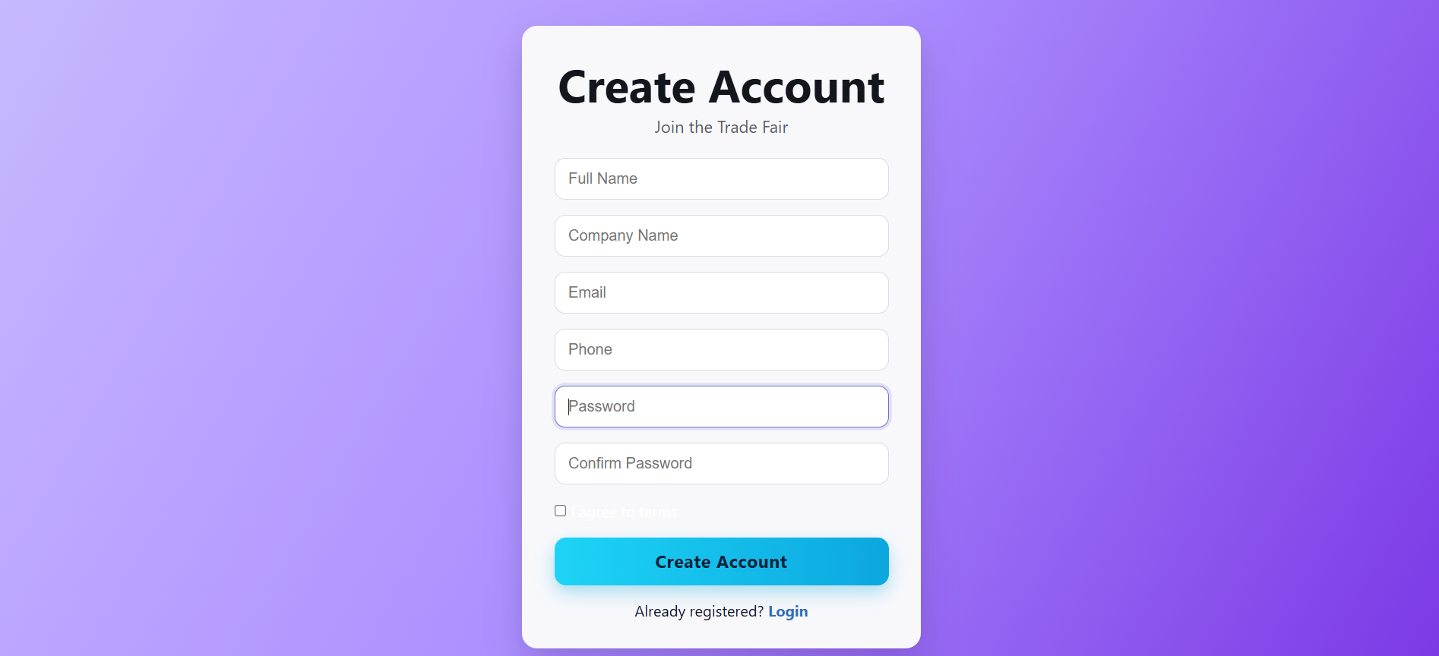

Full System demo

Slide 3
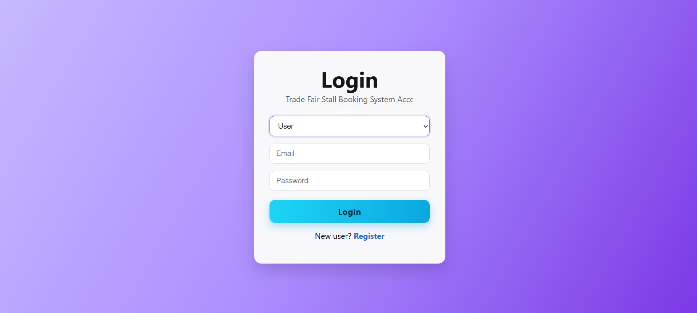


Slide 4
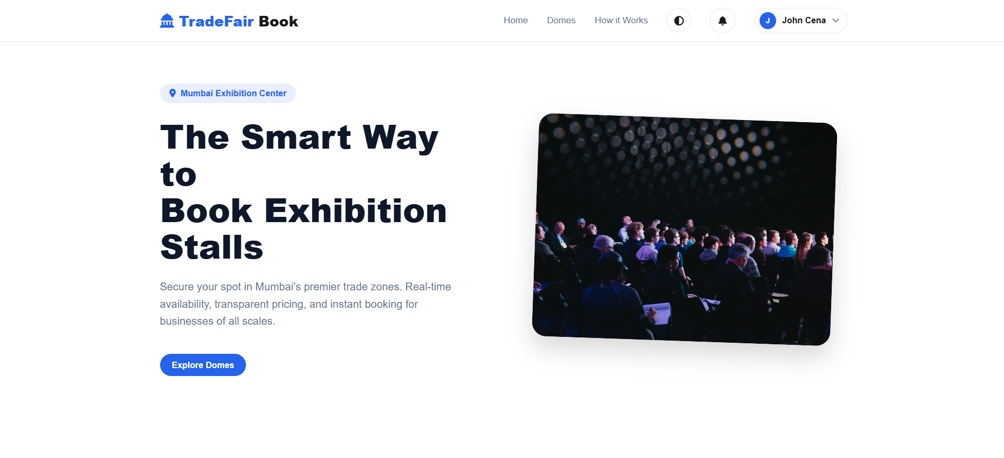

Home Page

Slide 5
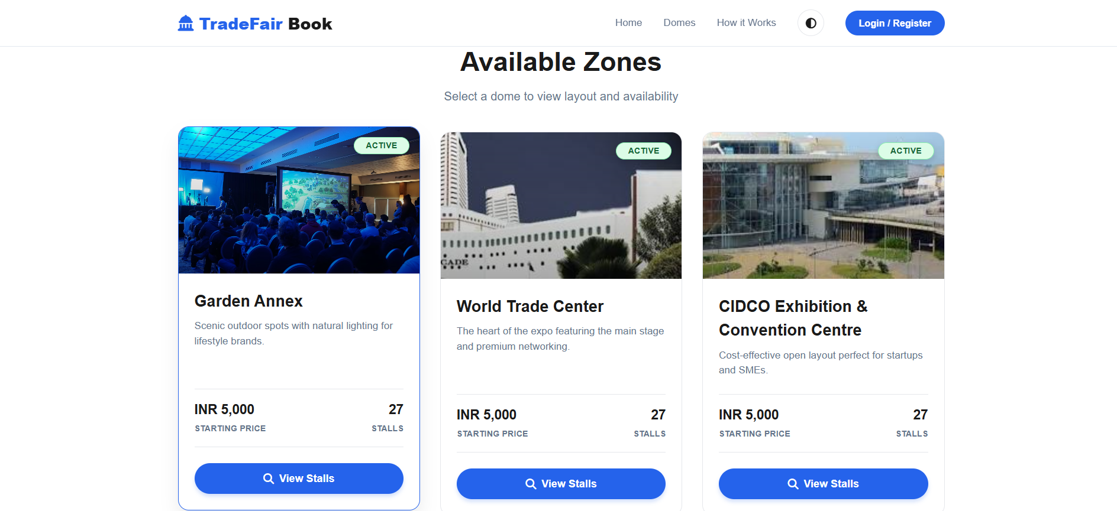


Slide 6
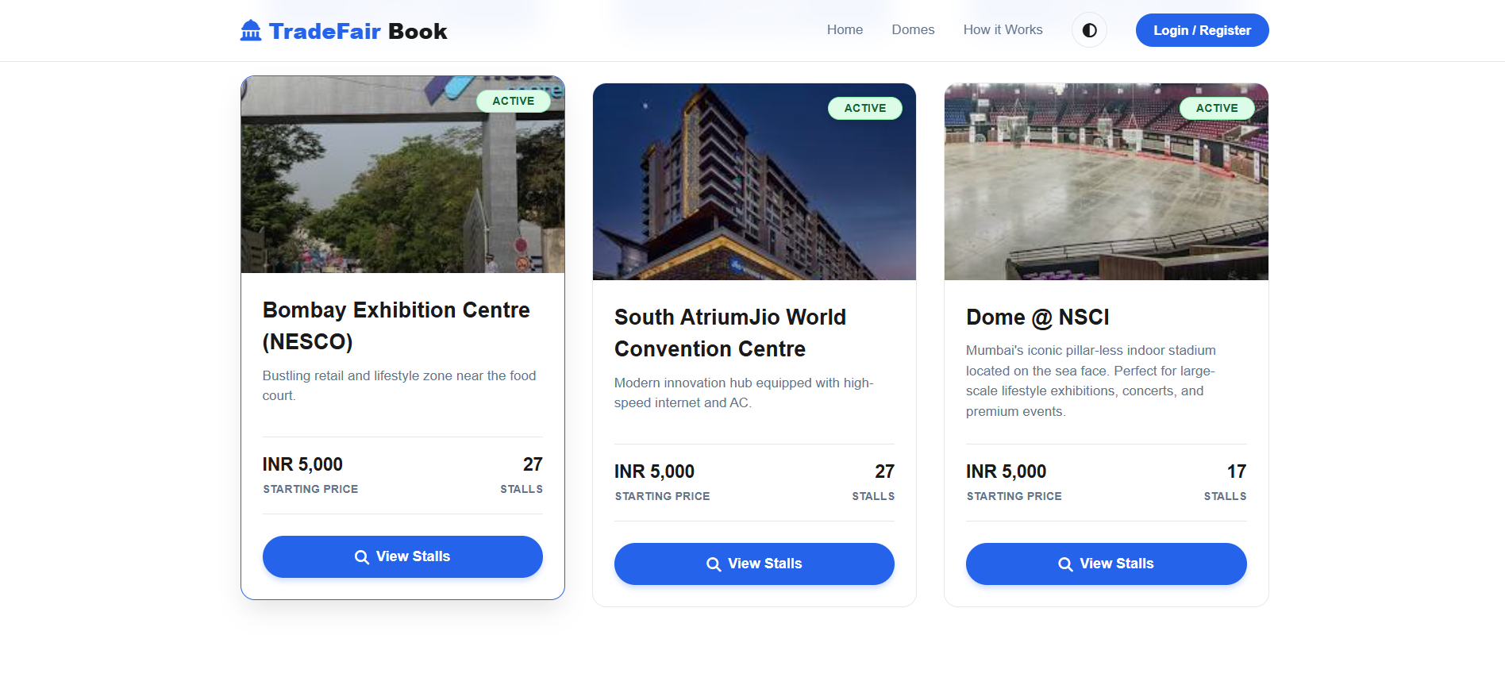

Slide 7
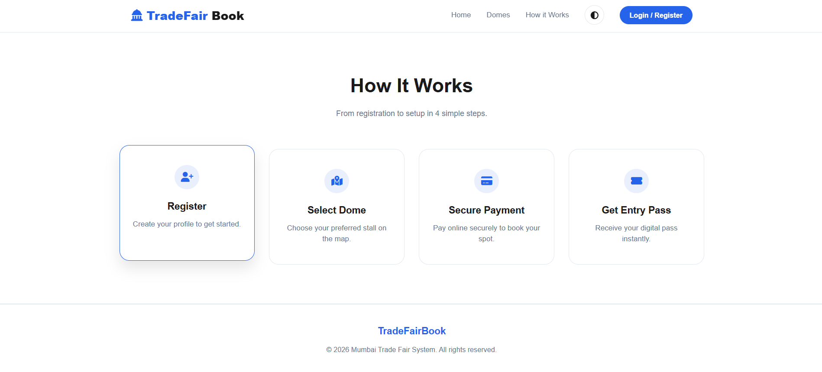

Slide 8
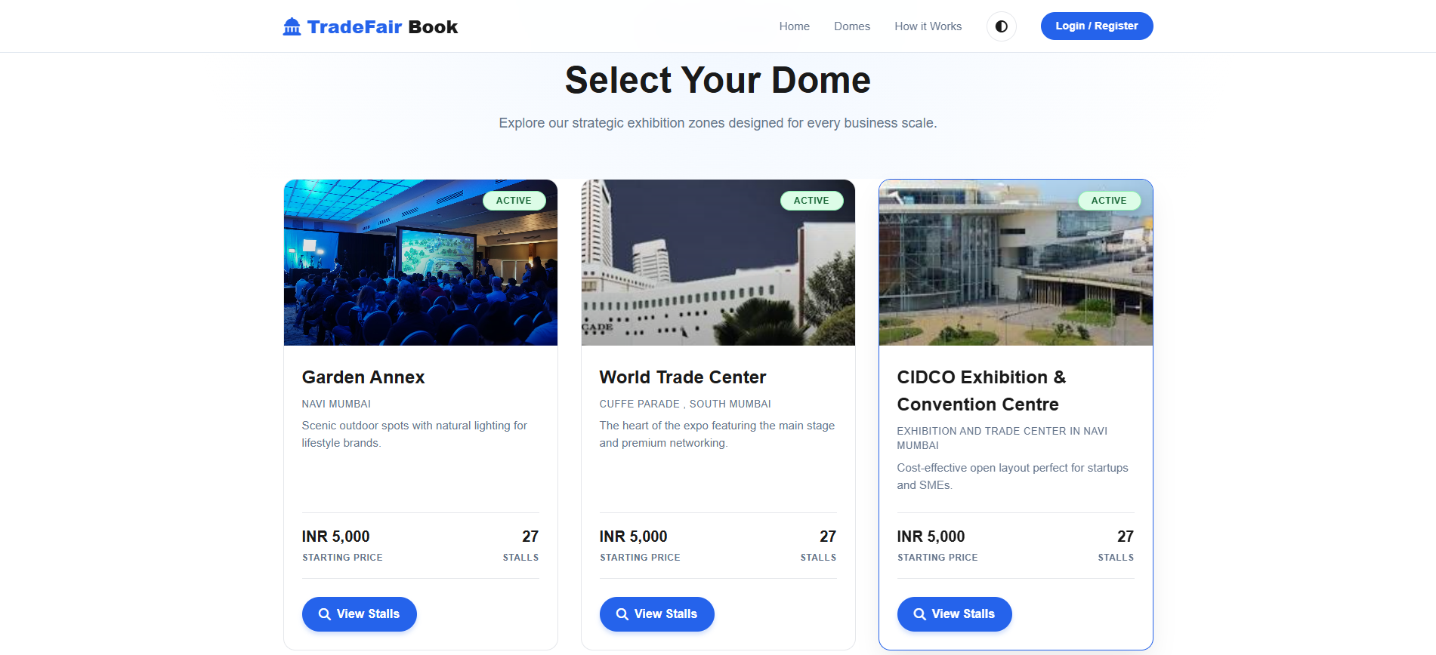
Dome Page

Slide 9
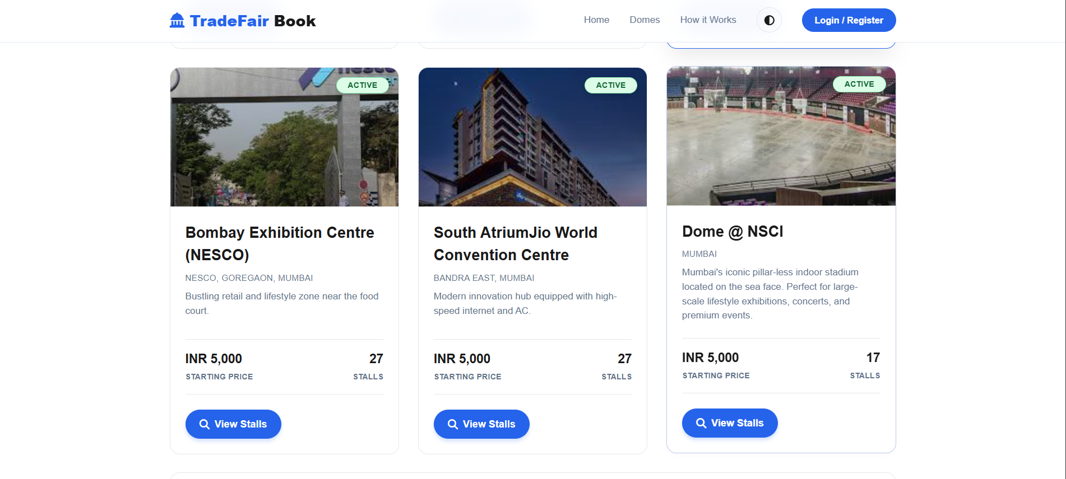

Slide 10
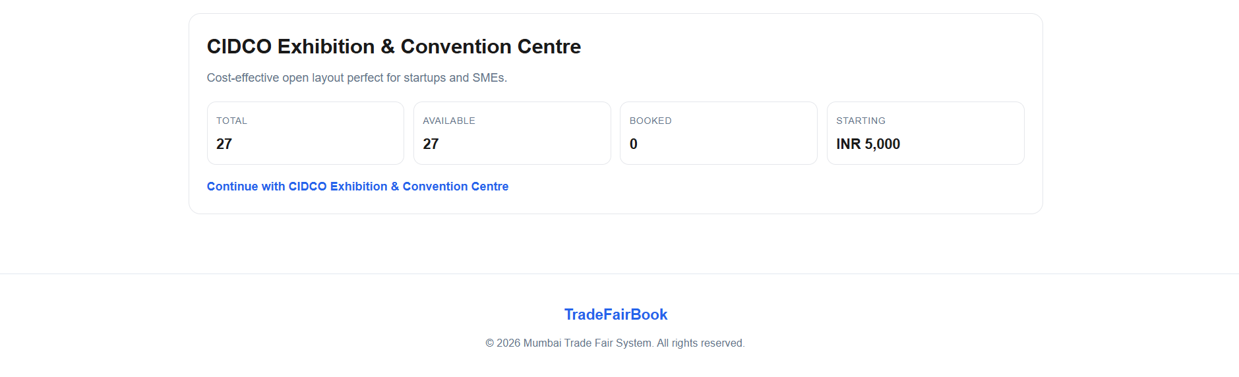

Slide 11
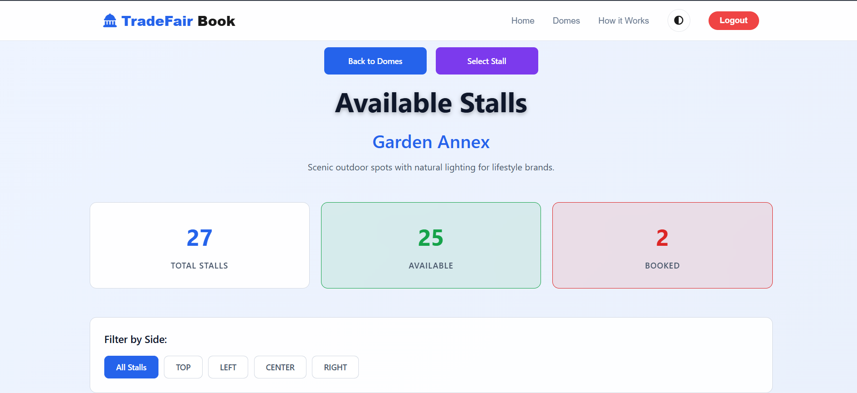
View Stall Page

Slide 12
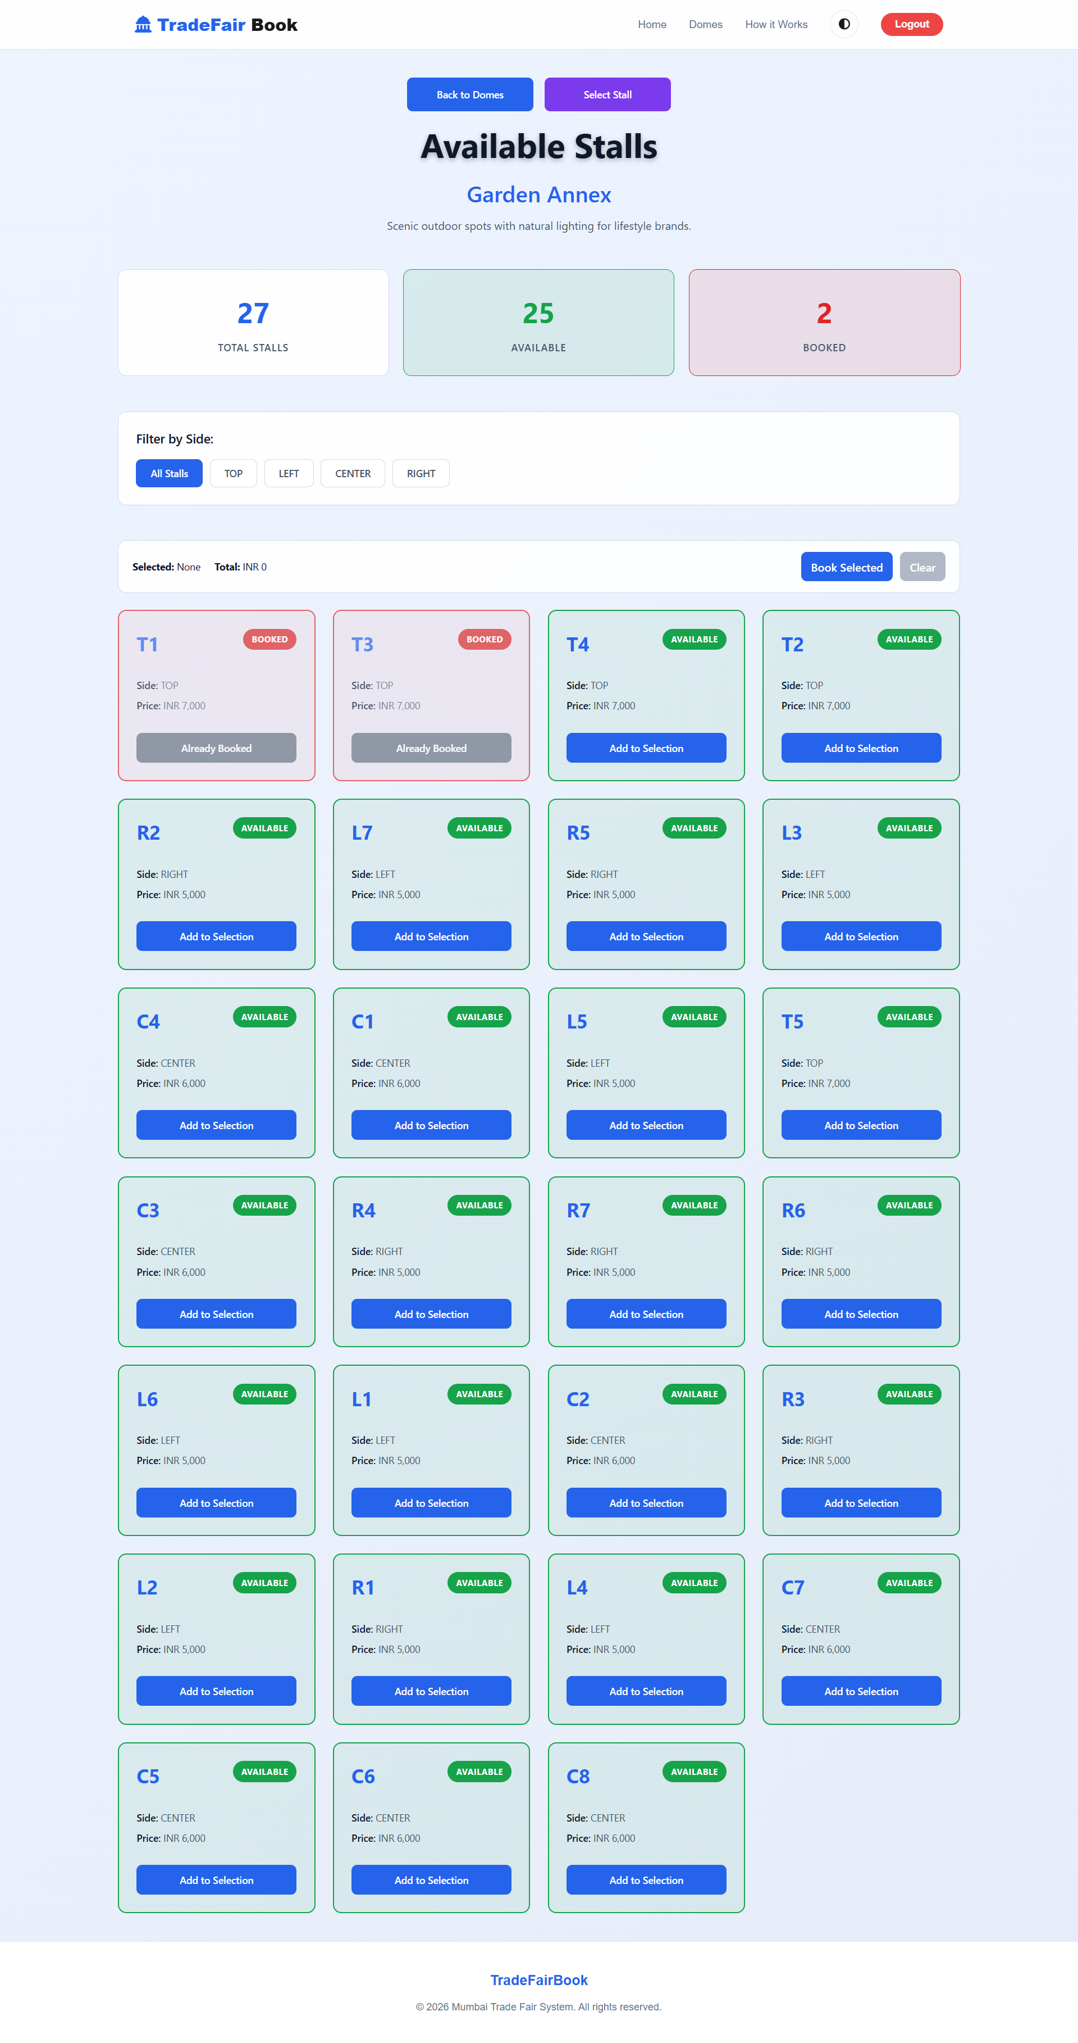

Slide 13
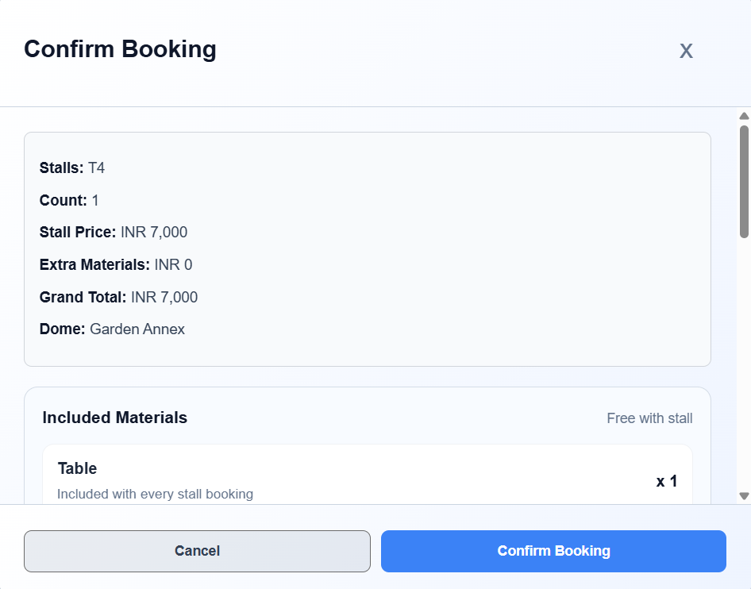

Slide 14
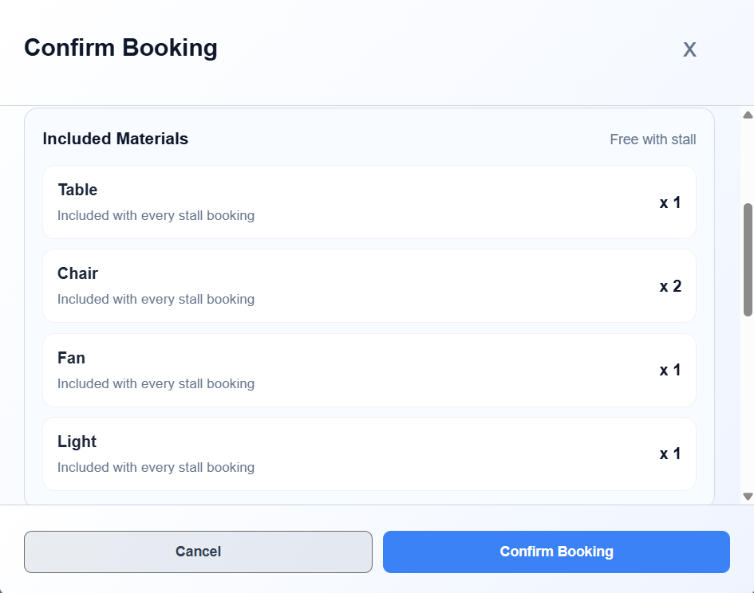

Slide 15
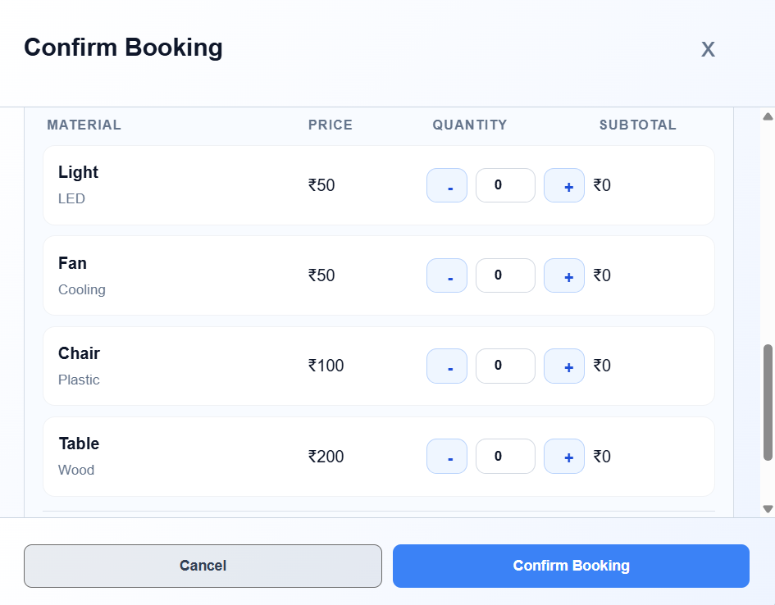

Slide 16
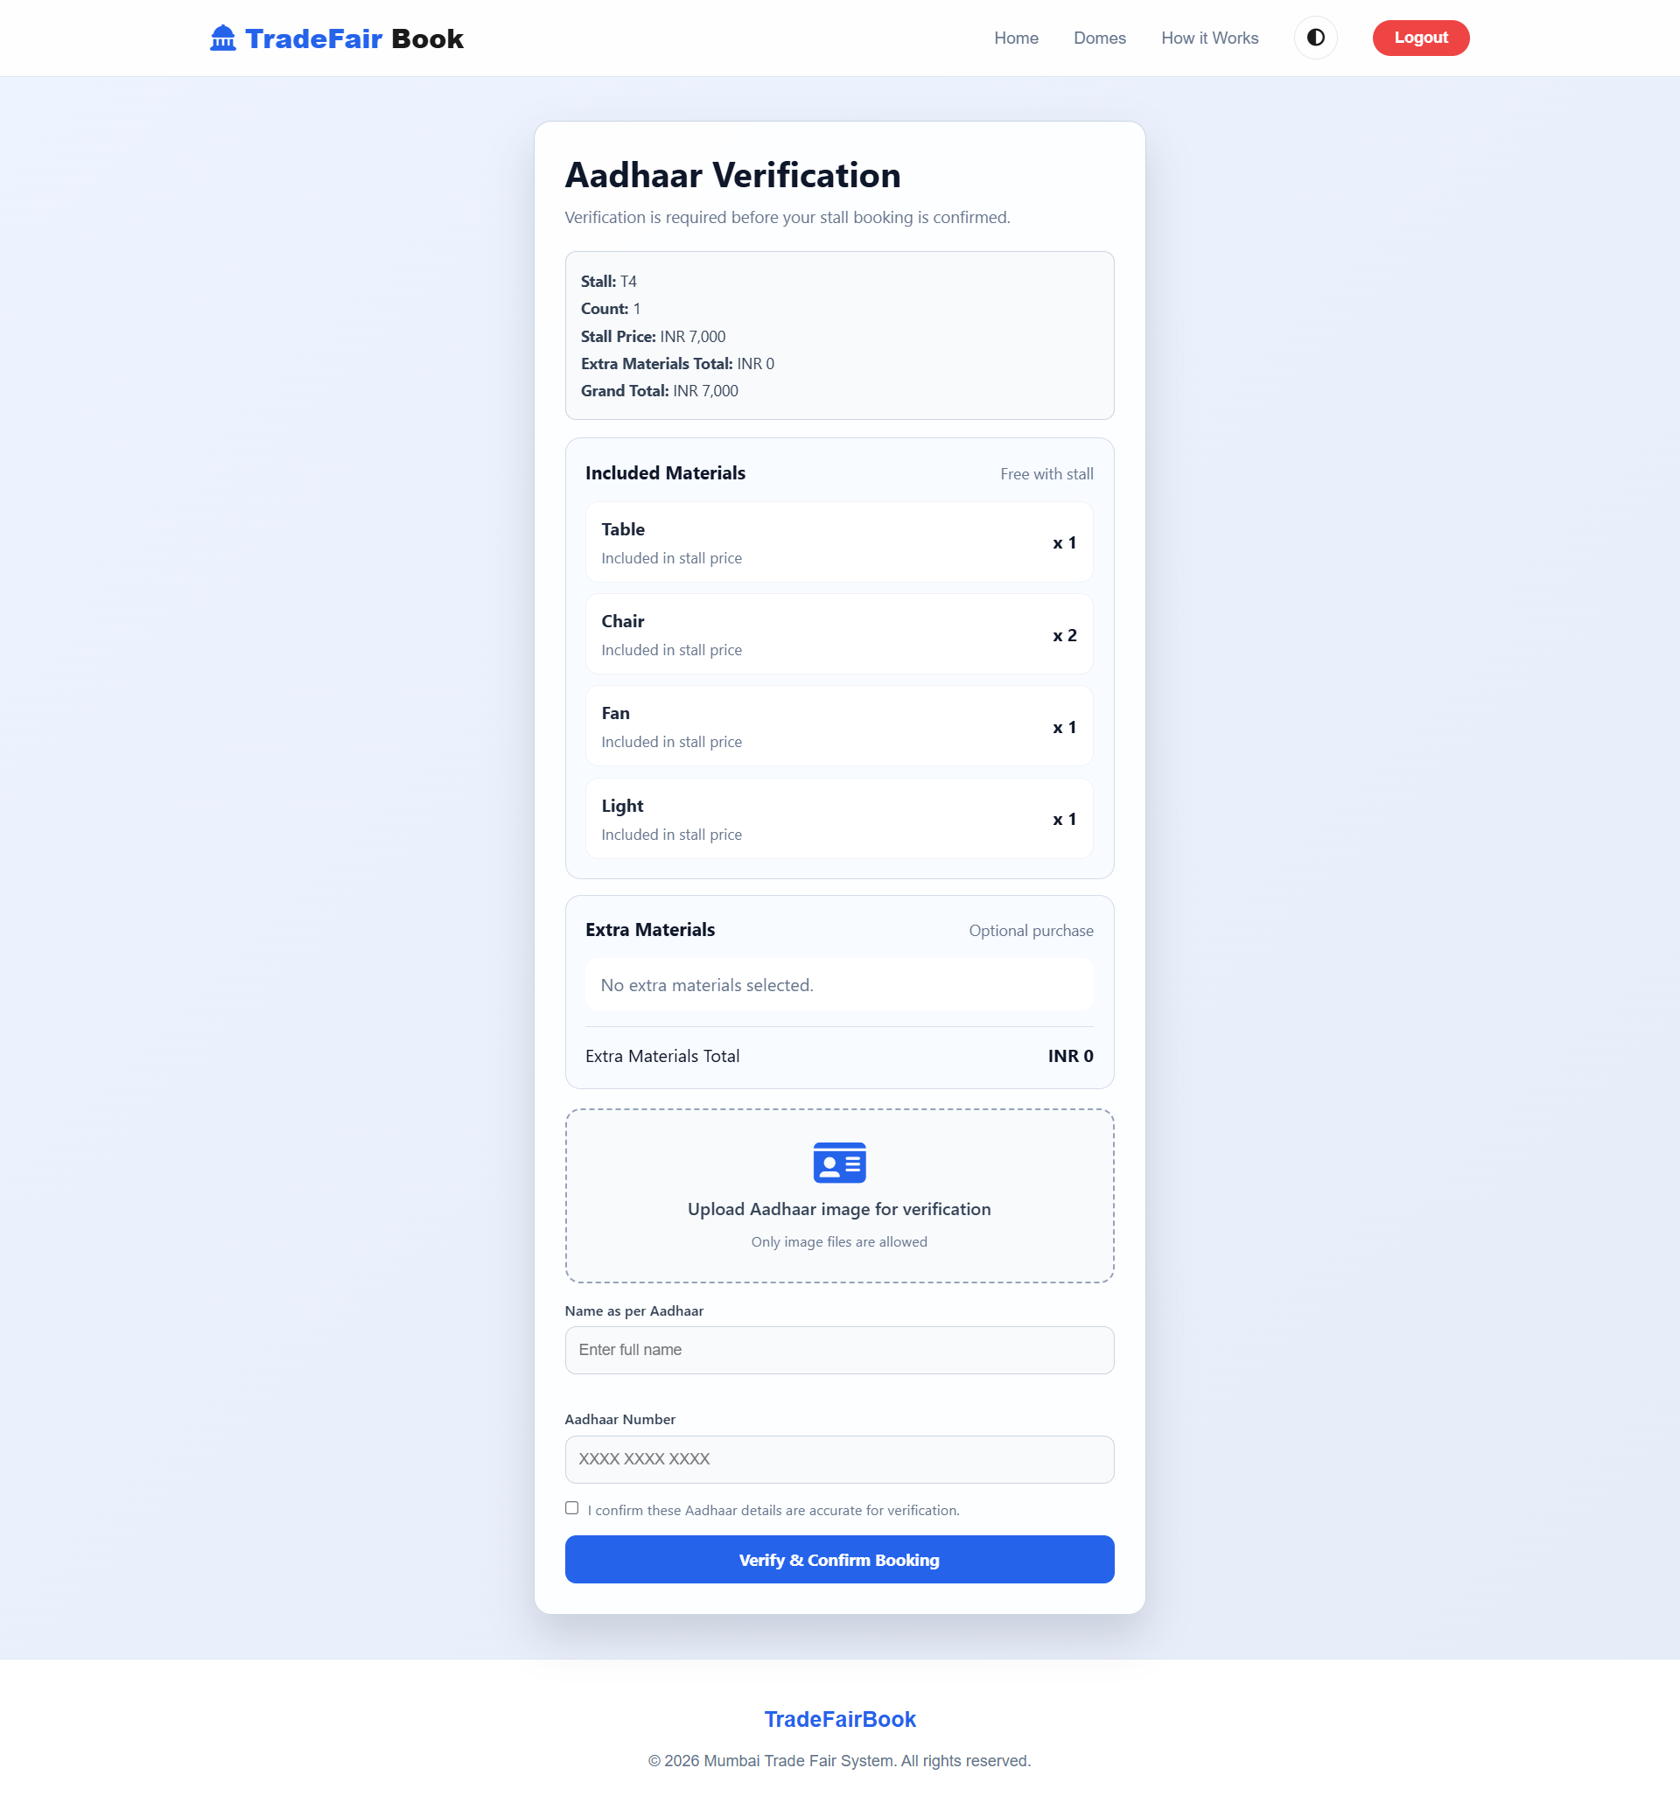


Slide 17
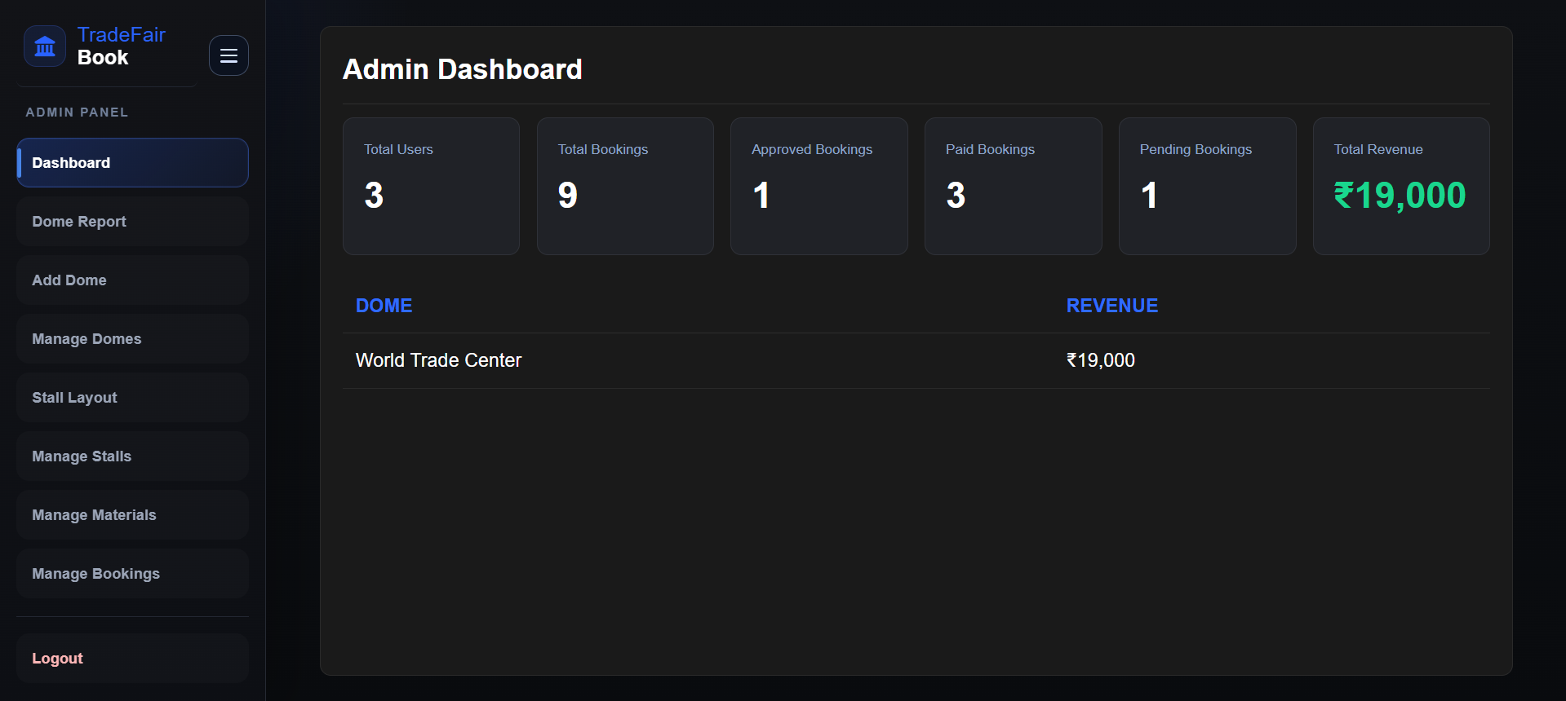
Admin Side

Slide 18
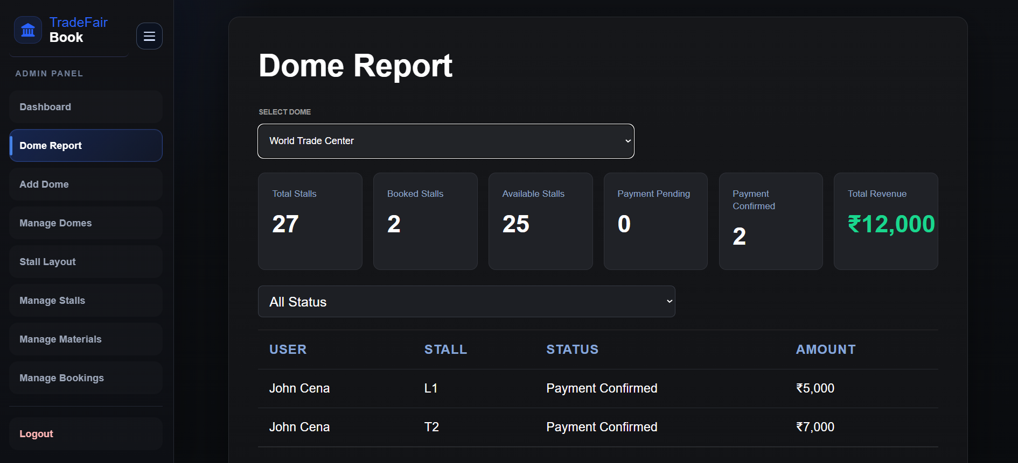

Slide 19
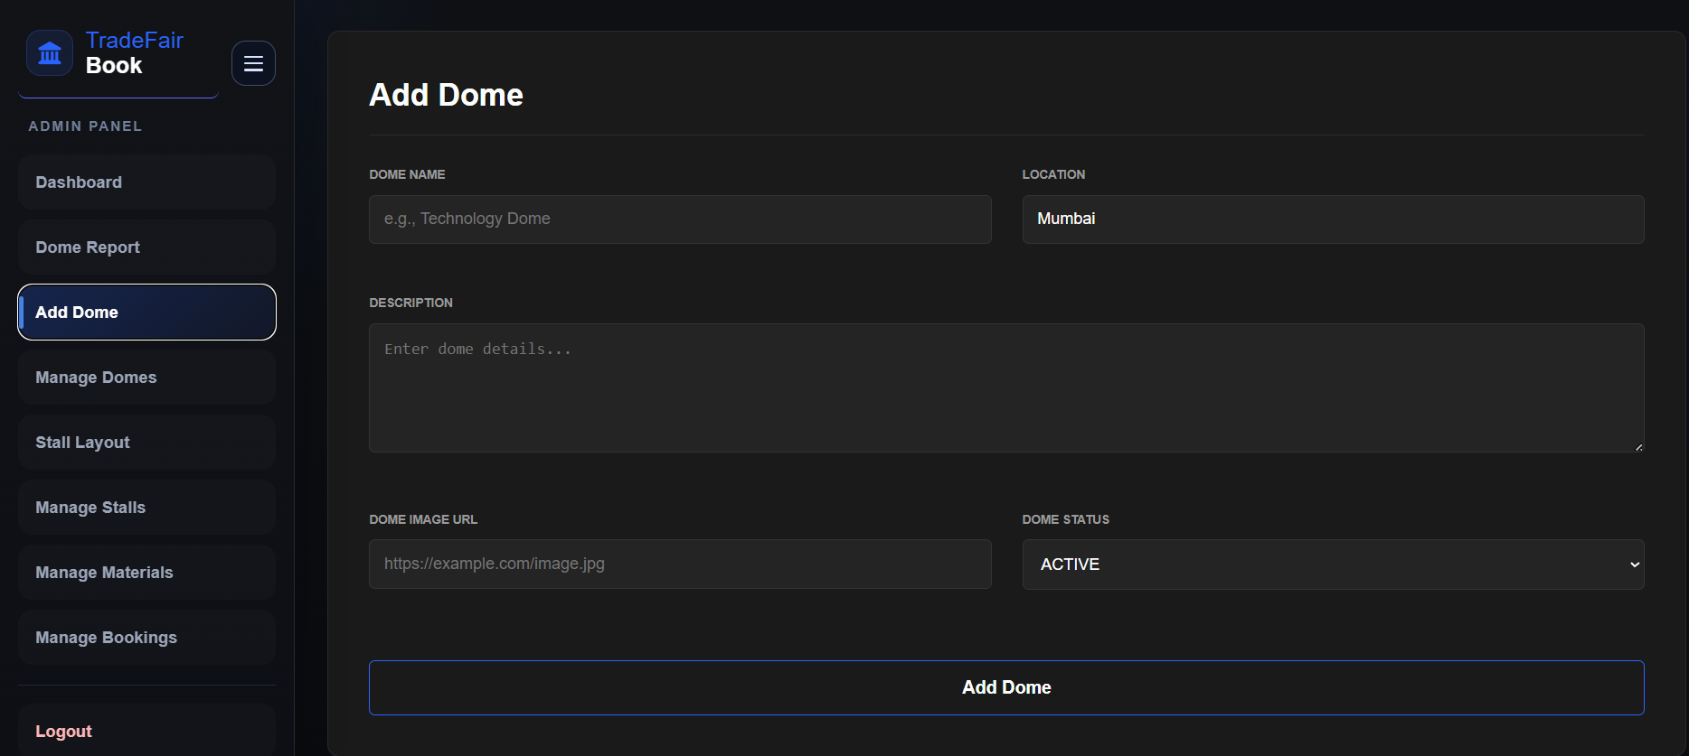

Slide 20
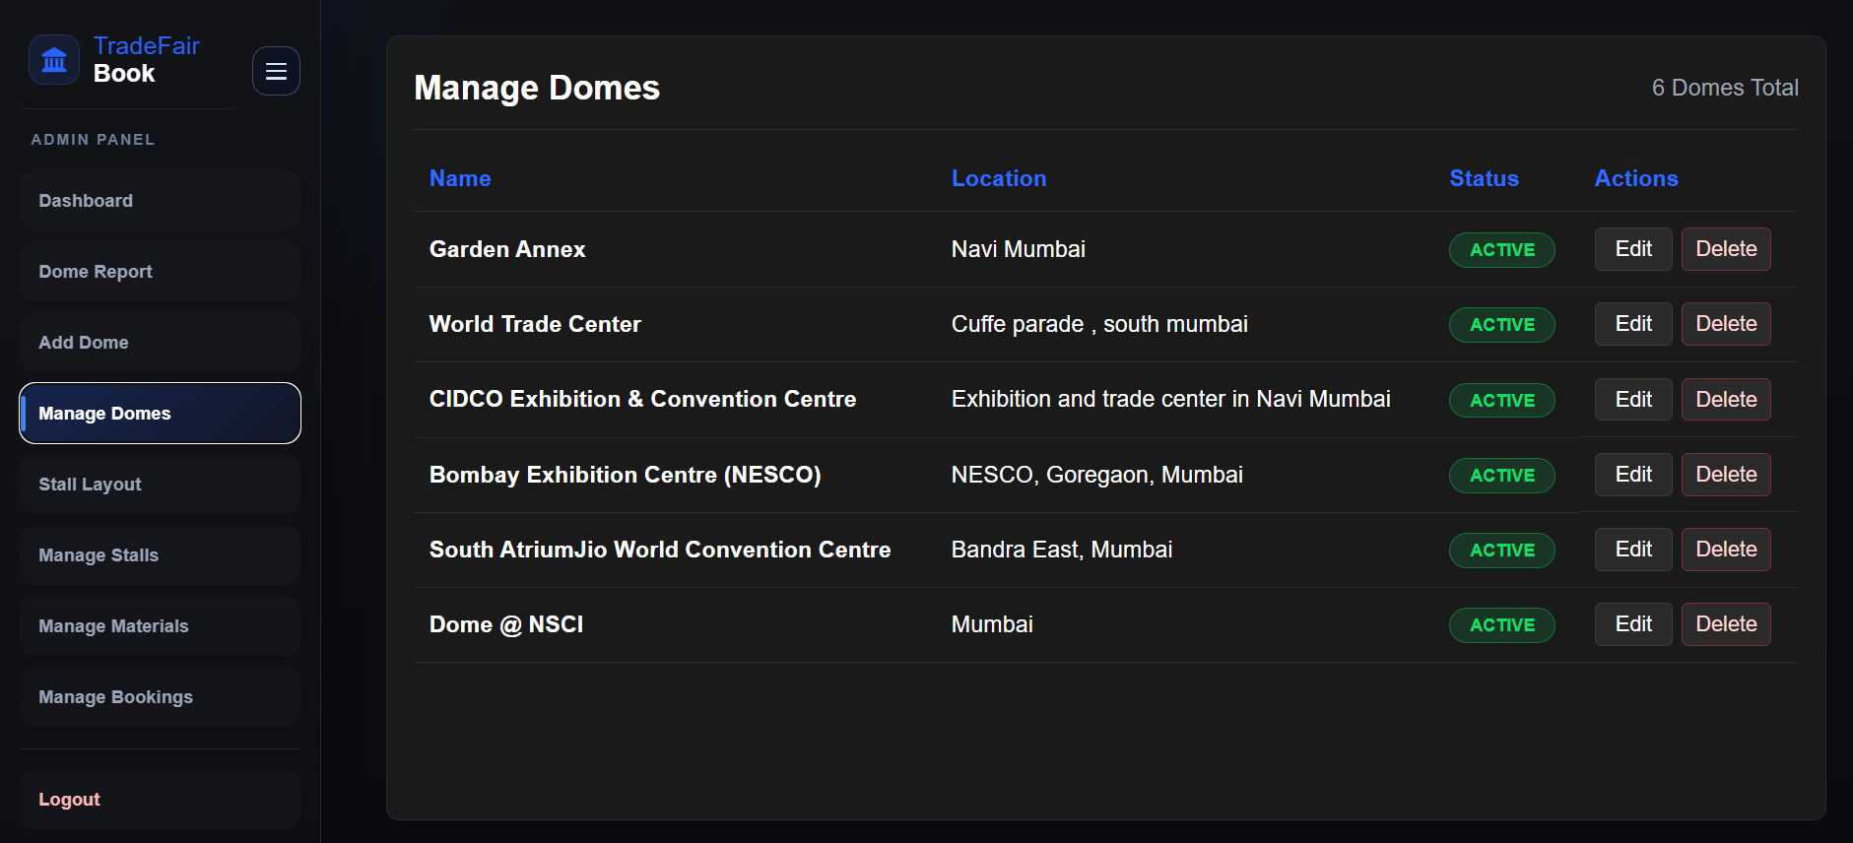

Slide 21
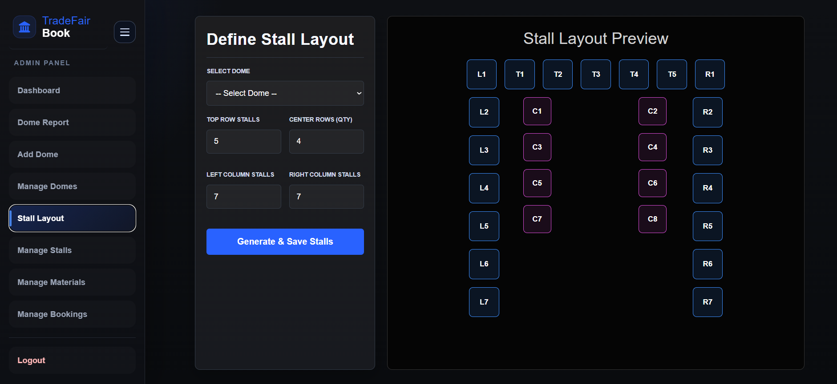

Slide 22
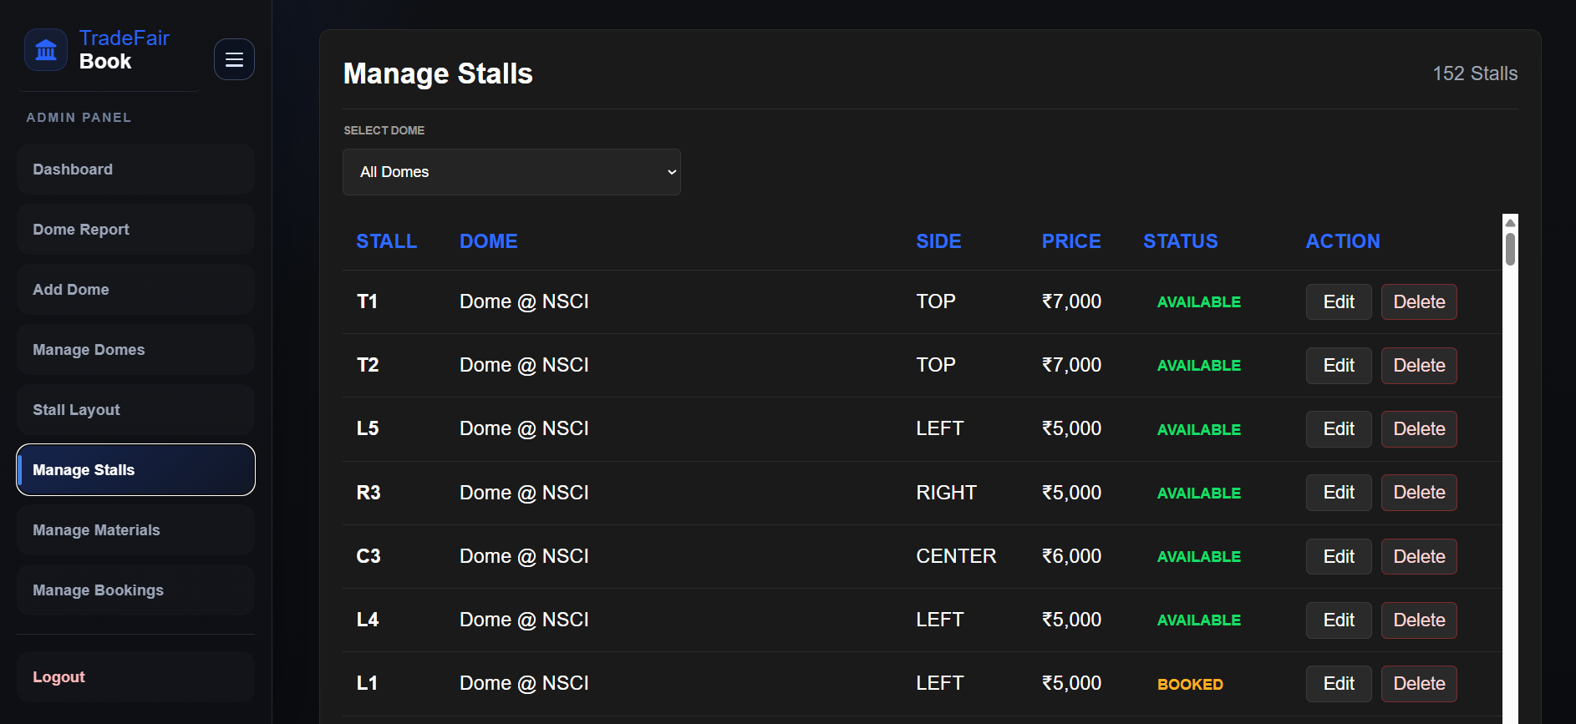

Slide 23
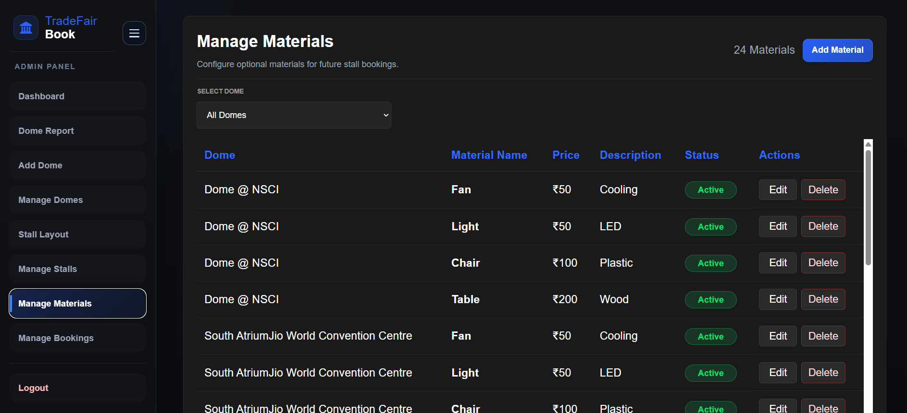

Slide 24
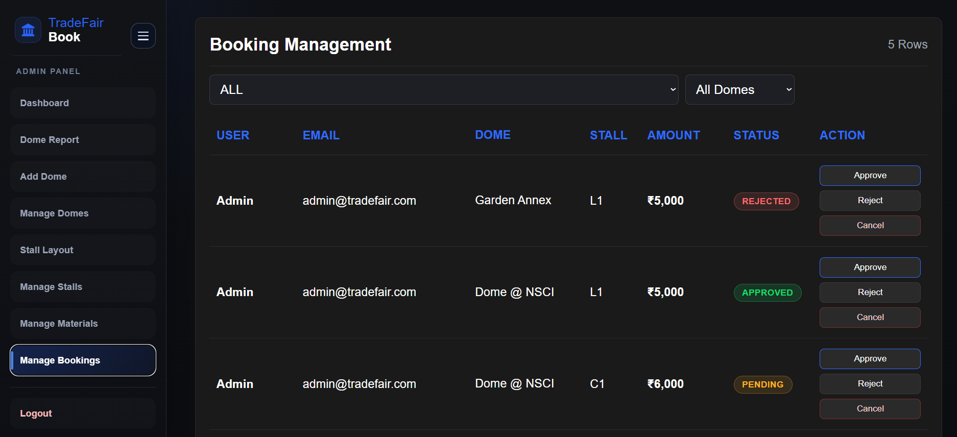

Slide 25
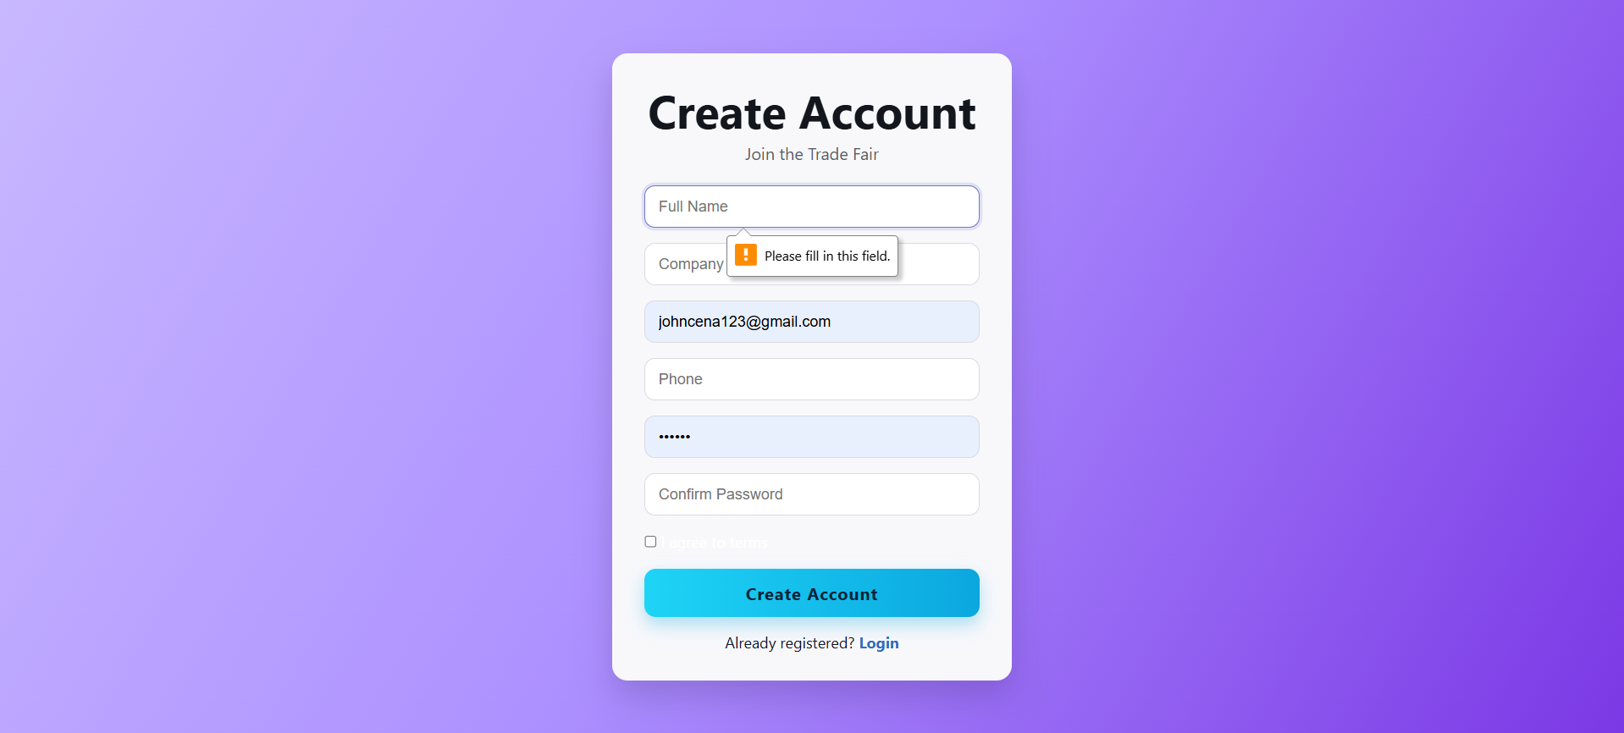
Testing

Slide 26
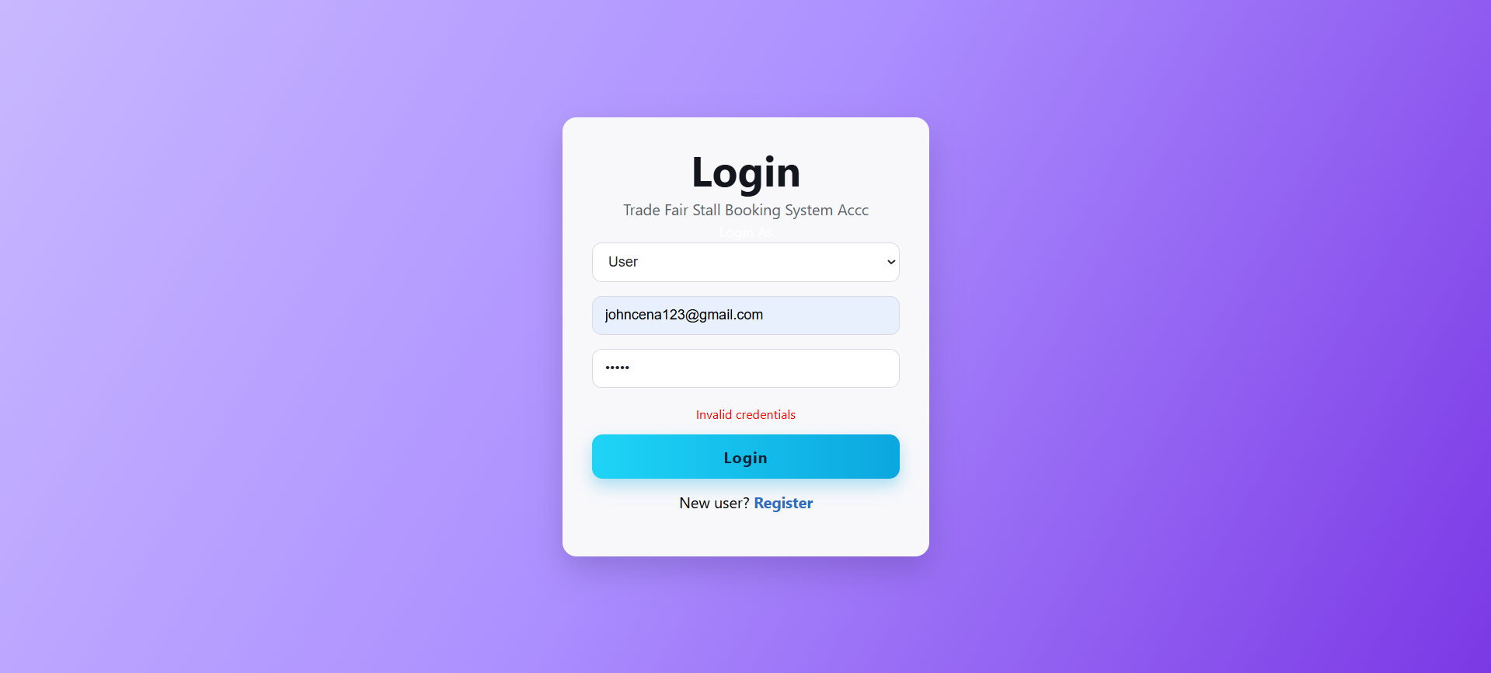

Slide 27

1 : - Test Case Title : - User Registration
objective :
- To verify that a new user can register successfully with valid details
Test scenario :
- Enter valid name, email, password, and required details in the registration form and submit
Expected Result :
- The system should create a new user account and store the details successfully
Actual Result :
- The user account was created successfully and registration completed without errors
Status : - Pass

Slide 28
2 : -Test Case Title - User Login with Valid Credentials
objective :
- To verify that a registered user can log in successfully
Test scenario:
- Enter valid email and password in the login form and click on login
Expected Result :
- The system should authenticate the user and redirect to the appropriate page
Actual Result :
- The user logged in successfully and was redirected correctly
Status - Pass

Slide 29
3 : -Test Case Title- User Login with Invalid Credentials
objective :
- To verify that the system blocks unauthorized login attempts
Test scenario:
- Enter invalid email or incorrect password and try to login
Expected Result :
- The system should display an error message and deny access
Actual Result :
- The system showed an error message and login was not allowed
Status - Pass

Slide 30
4: -Test Case Title- View Available Domes
objective :
- To verify that all available domes are displayed to the user
Test scenario:
- Open the dome selection page after login
Expected Result :
- The system should show the list of available domes with correct details
Actual Result :
- All available domes were displayed successfully with proper information
Status - Pass

Slide 31
5: -Test Case Title- View Stalls for Selected Dome
objective :
- To verify that stalls are displayed based on the selected dome
Test scenario:
- Select a dome and navigate to the stall display page
Expected Result :
- The system should display only the stalls that belong to the selected dome
Actual Result :
- The correct stalls for the selected dome were displayed successfully
Status - Pass

Slide 32
6 : -Test Case Title- Stall Booking Request
objective :
- To verify that a user can book an available stall
Test scenario:
- Select an available stall and submit the booking request with required details
Expected Result :
- The booking should be created successfully and stall status should update accordingly
Actual Result :
- The booking was created successfully and the stall status was updated
Status - Pass

Slide 33
7 : -Test Case Title- Aadhaar Upload Verification
objective :
- To verify that the Aadhaar document upload works correctly
Test scenario:
- Upload a valid Aadhaar image/document during the booking process
Expected Result :
- The document should be uploaded successfully and linked to the user verification process
Actual Result :
- The Aadhaar document was uploaded successfully and saved in the system
Status - Pass

Slide 34

8 : -Test Case Title- Admin Creates New Dome
objective :
- To verify that the admin can add a new dome successfully
Test scenario:
- Log in as admin, enter valid dome details, and submit the create dome form
Expected Result :
- A new dome should be created and displayed in the dome list
Actual Result :
- The new dome was created successfully and appeared in the system
Status - Pass

Slide 35
9 : -Test Case Title- Admin Creates Stalls
objective :
- To verify that the admin can create stalls for a selected dome
Test scenario:
- Log in as admin, enter valid stall details, and create multiple stalls
Expected Result :
- The stalls should be created successfully and mapped to the selected dome
Actual Result :
- The stalls were created successfully and stored under the selected dome
Status - Pass

Slide 36
10 : -Test Case Title- Admin Updates Stall Details
objective :
- To verify that stall details can be updated by the admin
Test scenario:
- Edit stall price or status from the admin panel and save changes
Expected Result :
- The updated stall details should be saved and reflected in the system
Actual Result :
The stall details were updated successfully and displayed correctly
Status - Pass

Slide 37
11 : -Test Case Title- Booking Cancellation
objective :
- To verify that an existing booking can be cancelled successfully
Test scenario:
- Select an existing booking and perform the cancel action
Expected Result :
- The booking status should change to cancelled and the system should update records correctly
Actual Result :
- The booking was cancelled successfully and the status was updated
Status - Pass

Slide 38
12: -Test Case Title- Admin Booking Management
objective :
- To verify that the admin can view and manage all bookings
Test scenario:
- Log in as admin, open booking management, and update the booking status
Expected Result :
- All bookings should be visible and status updates should be saved successfully
Actual Result :
- The admin was able to view all bookings and update booking status successfully
Status - Pass

Slide 39
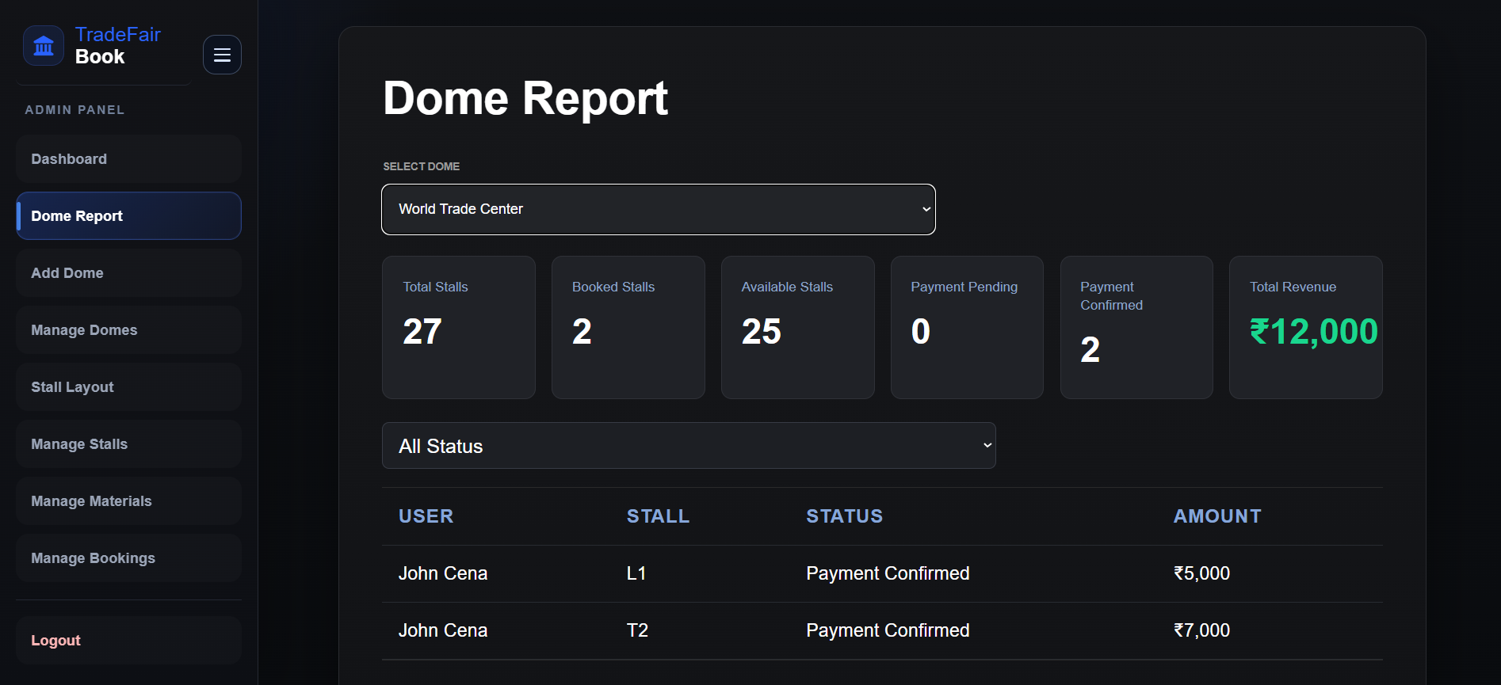
Report

